Slide 1

ASI PantherCentric 1.0
Team Members: Alfredo Santoyo, Jake Lopez, Priscila Cordova, Rolando Moreno Product Owner: Myrian Herle
Instructor: Masoud Sadjadi School of Computing and Information Sciences Florida International University
Final Presentation
Summer 2017
Notes:
7 seconds.( I will select 2 best slides (i will give them extra points and students will present for CIS committee)
Greet your audience, thank them for attending your presentation, introduce yourself, introduce your project, introduce your team members, and quickly indicate what each of you did in a high-level manner, and put more emphasis on your part/contribution.

Slide 2
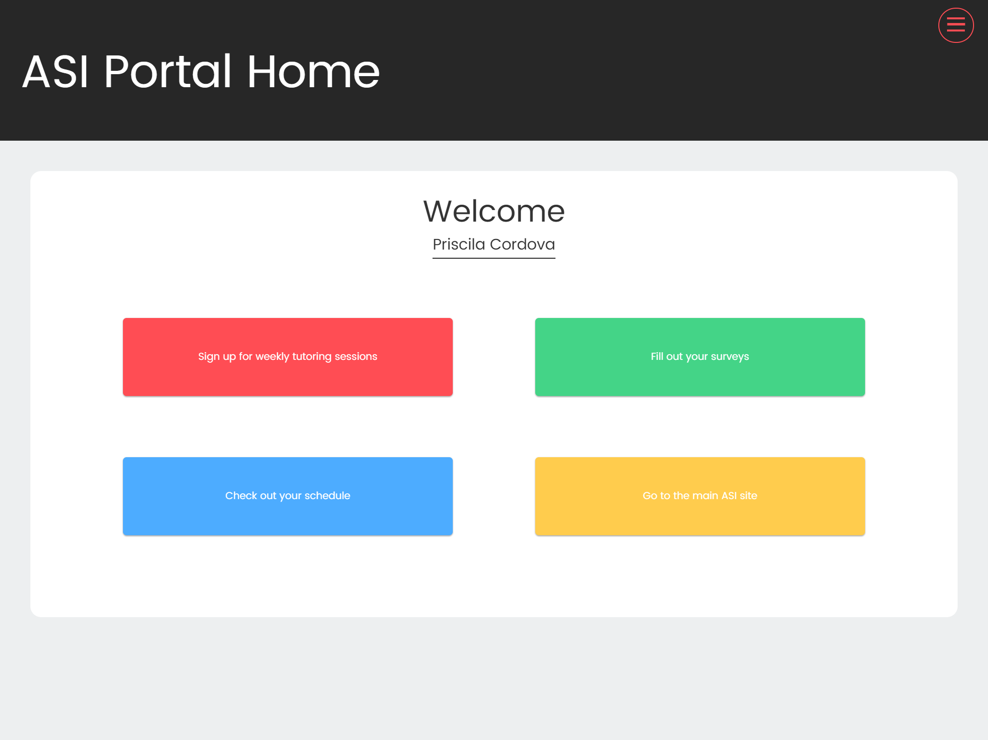
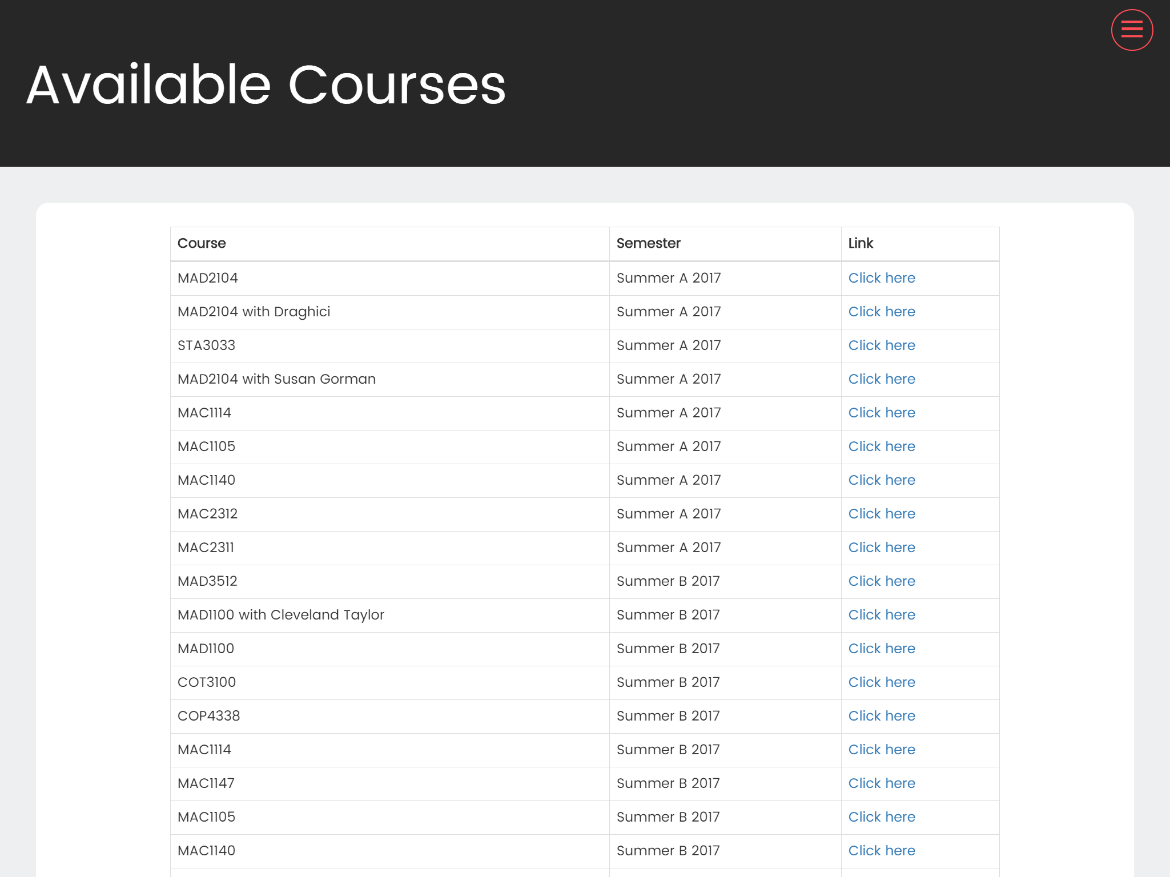
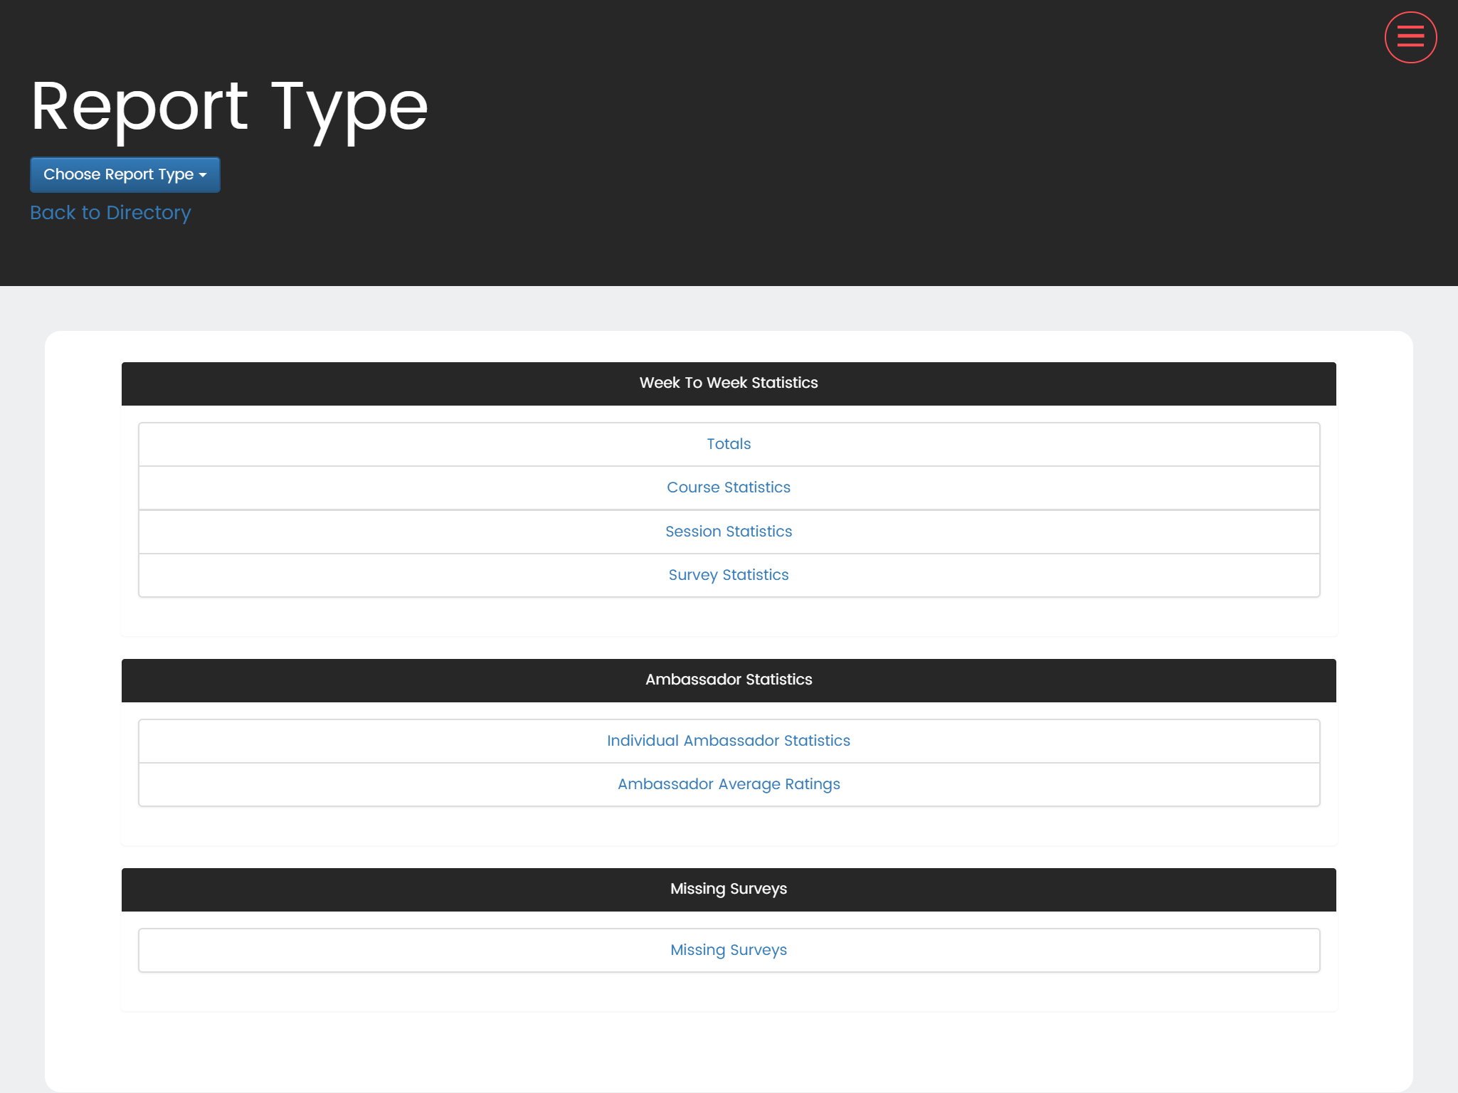
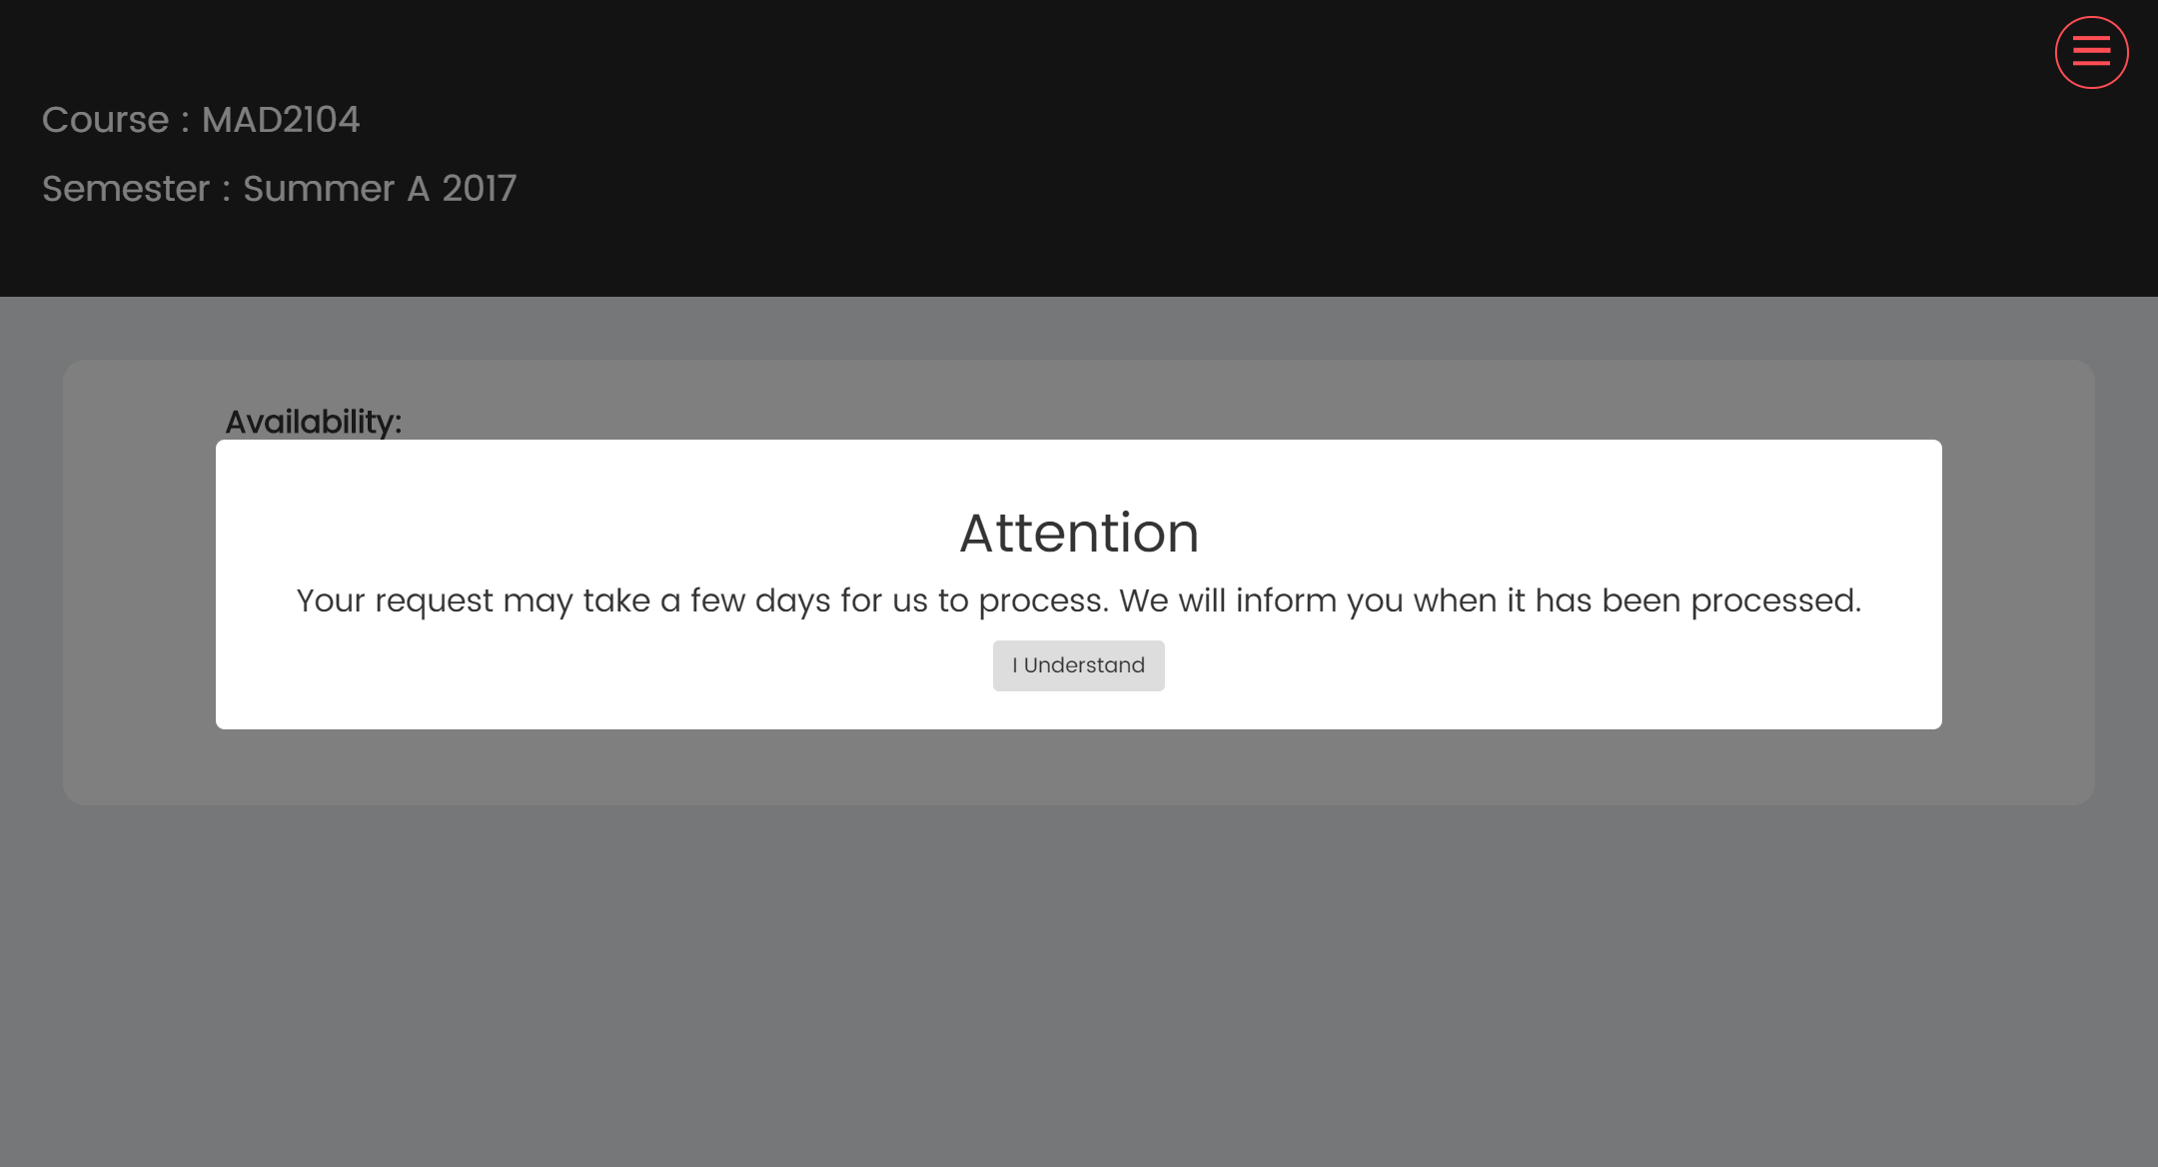
Project definition
Notes:
10 seconds.
Introduce the problem that the whole project (in all versions) tackles with GIF or screenshot.

Slide 3
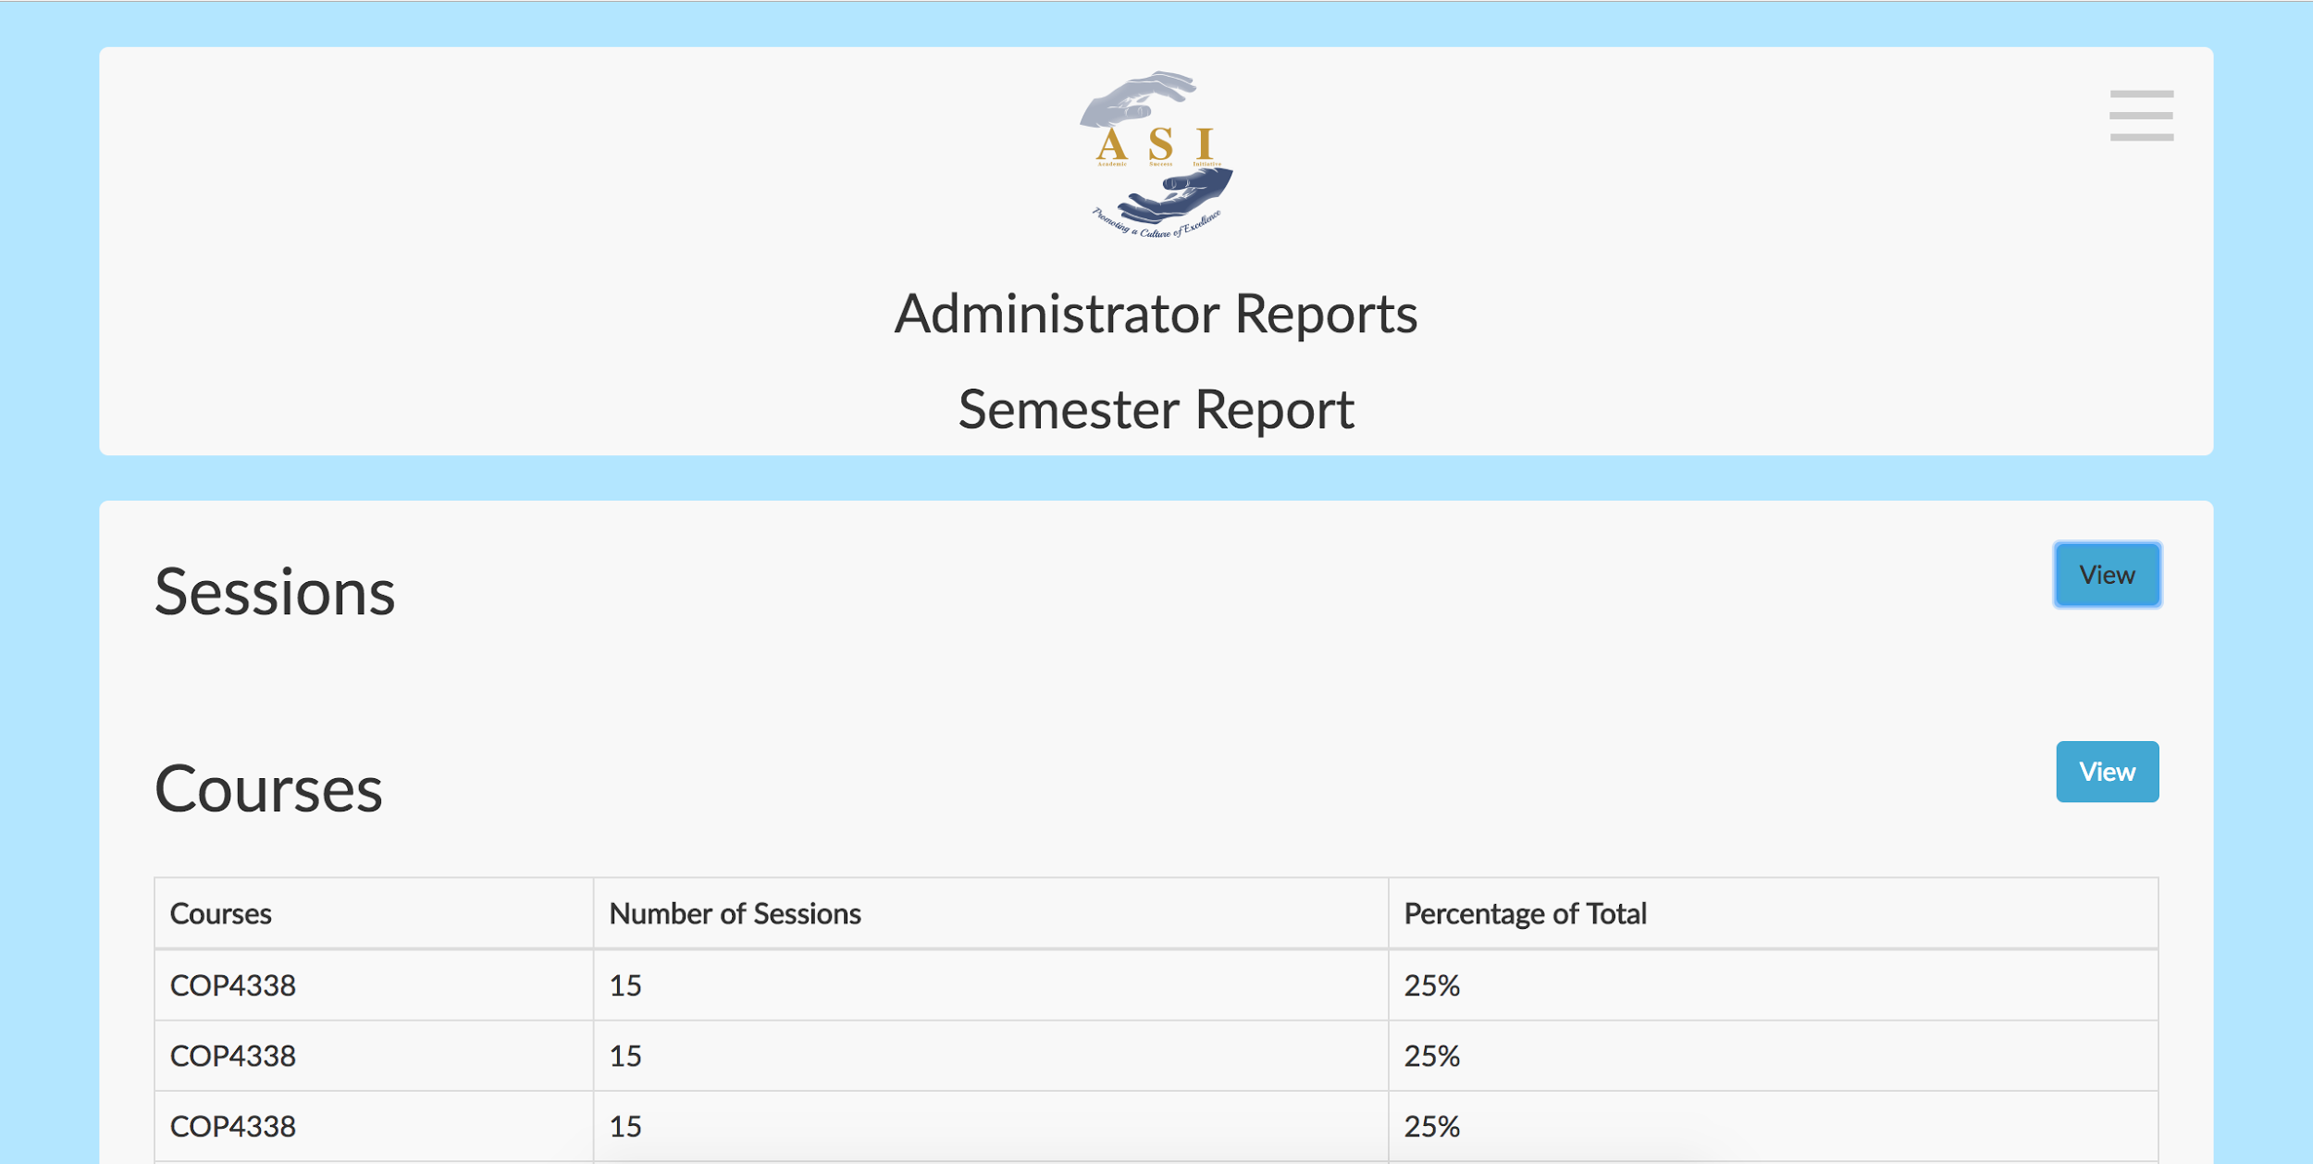
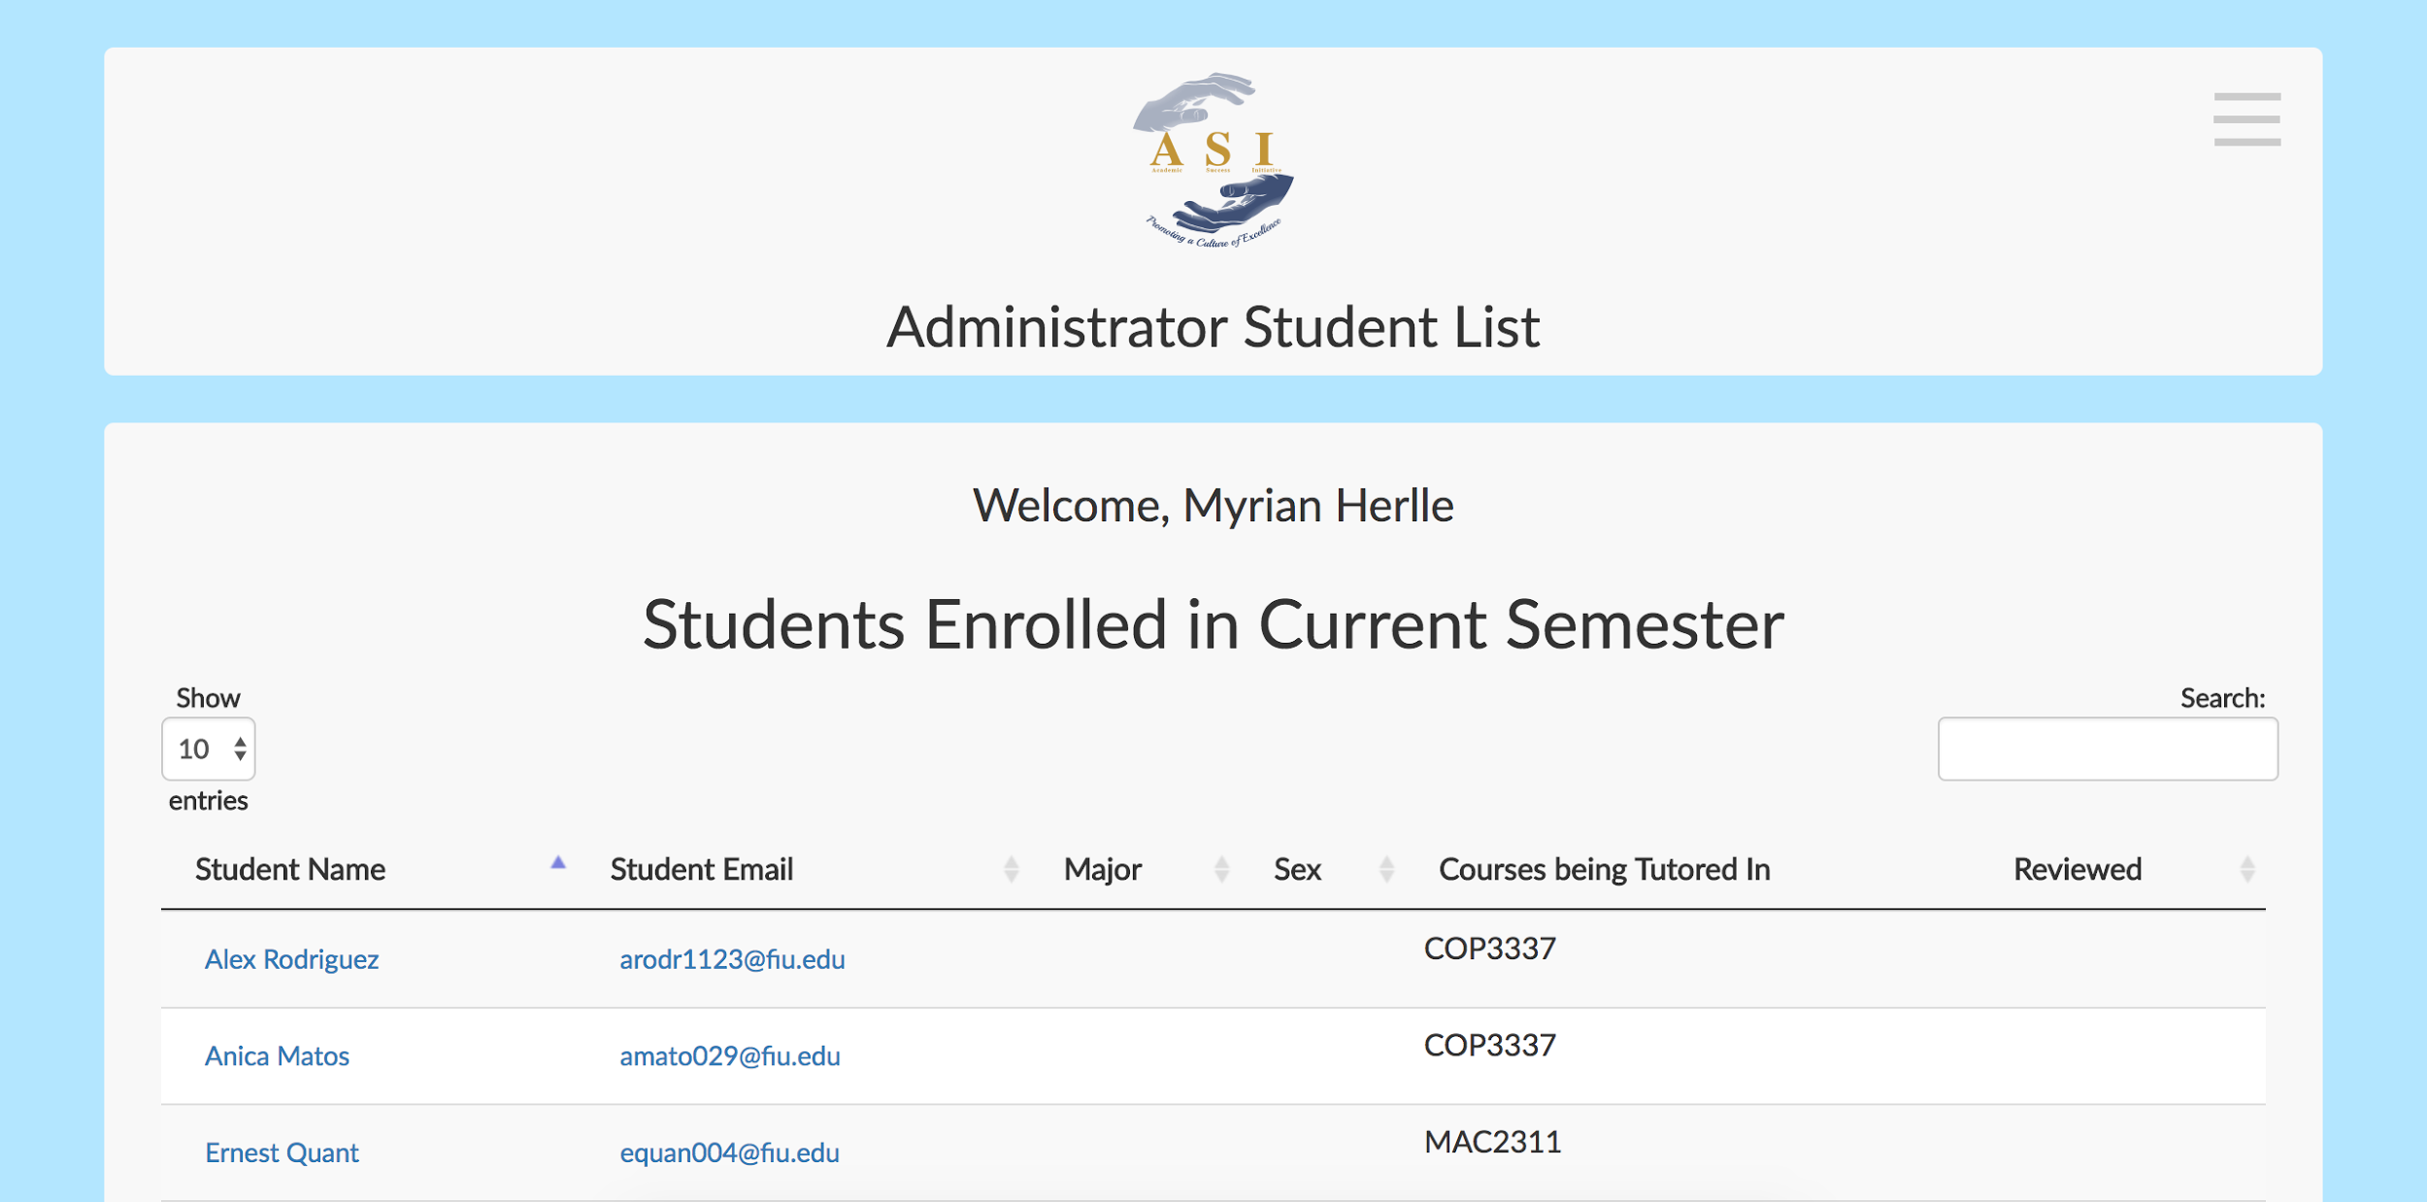
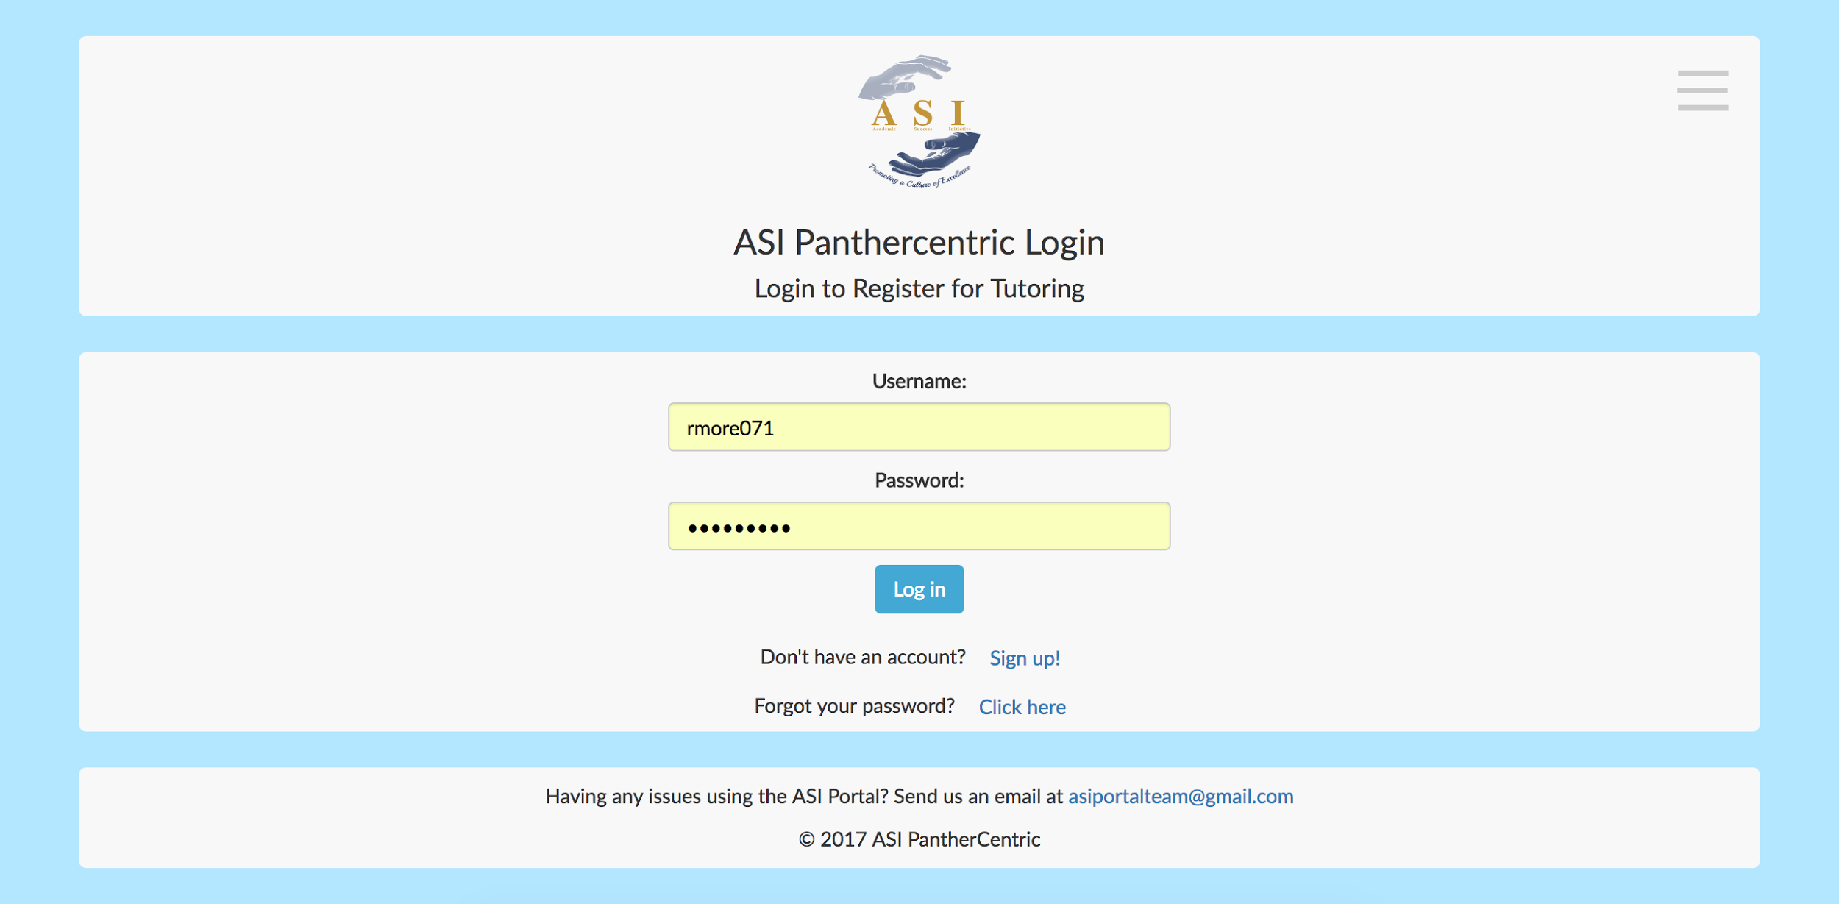
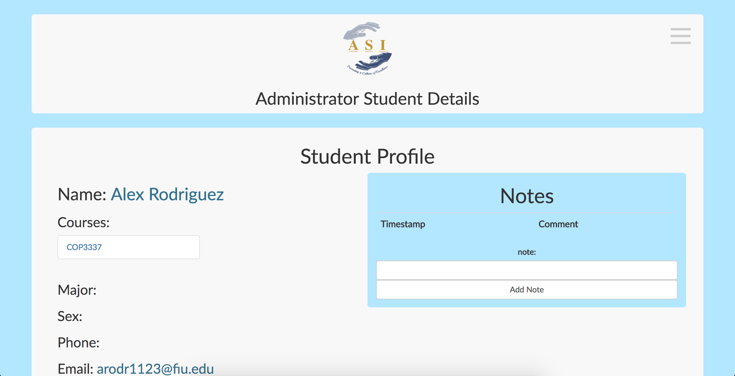
Project definition
Notes:
20 seconds.
Introduce the problem that the your project (in new version) tackles with GIF or screenshot.

Slide 4
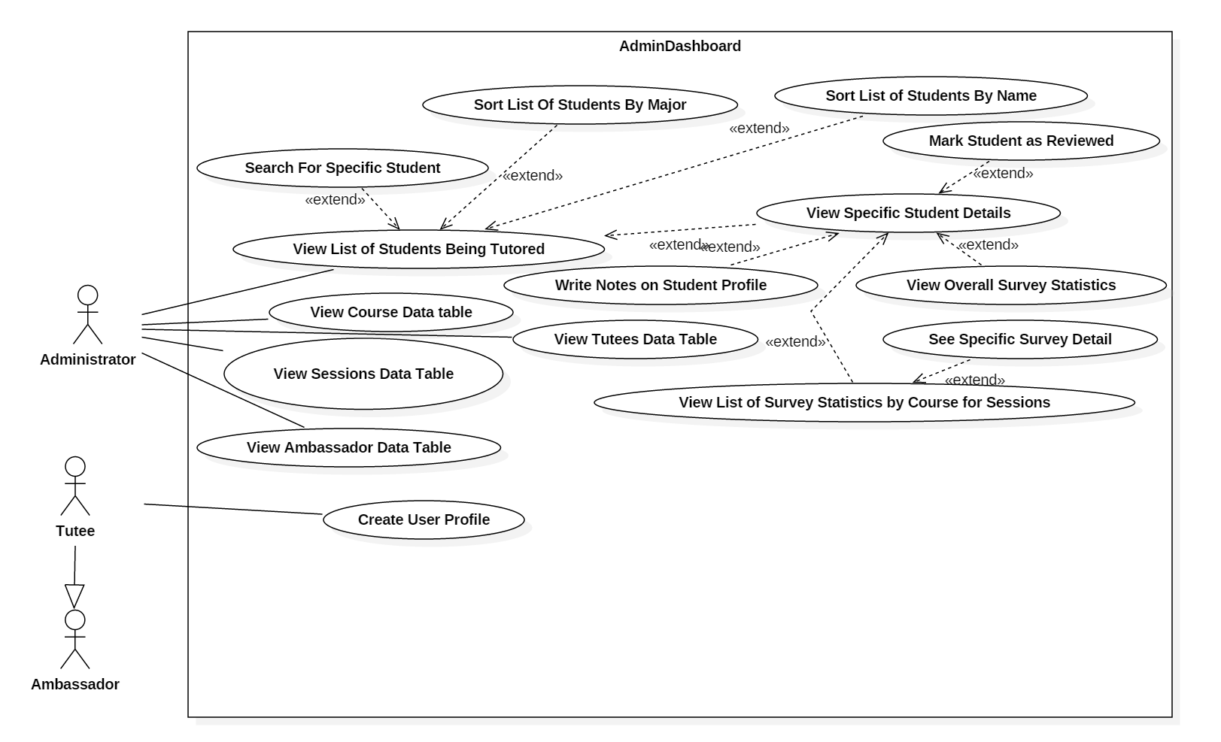
Requirements: Use Cases
Notes:
5 seconds
Show the Use Case Diagram for the whole project. Highlight your use cases.

Slide 5

System Design: Architecture
Model View Controller (MVC)
Notes:
20 seconds
System design: Highlight the parts that you contributed to them.
1. System decomposition; identify the architecture patterns used
2. System deployment – h/w and s/w requirements

Slide 6
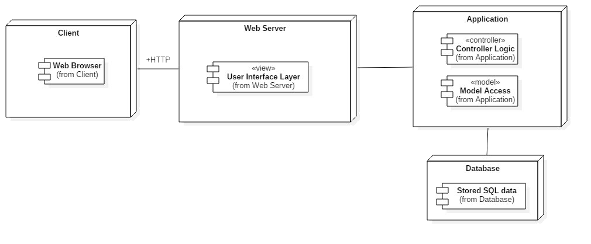
System Design: Architecture
Deployment Diagram
Notes:
20 seconds
System design: Highlight the parts that you contributed to them.
1. System decomposition; identify the architecture patterns used
2. System deployment – h/w and s/w requirements

Slide 7
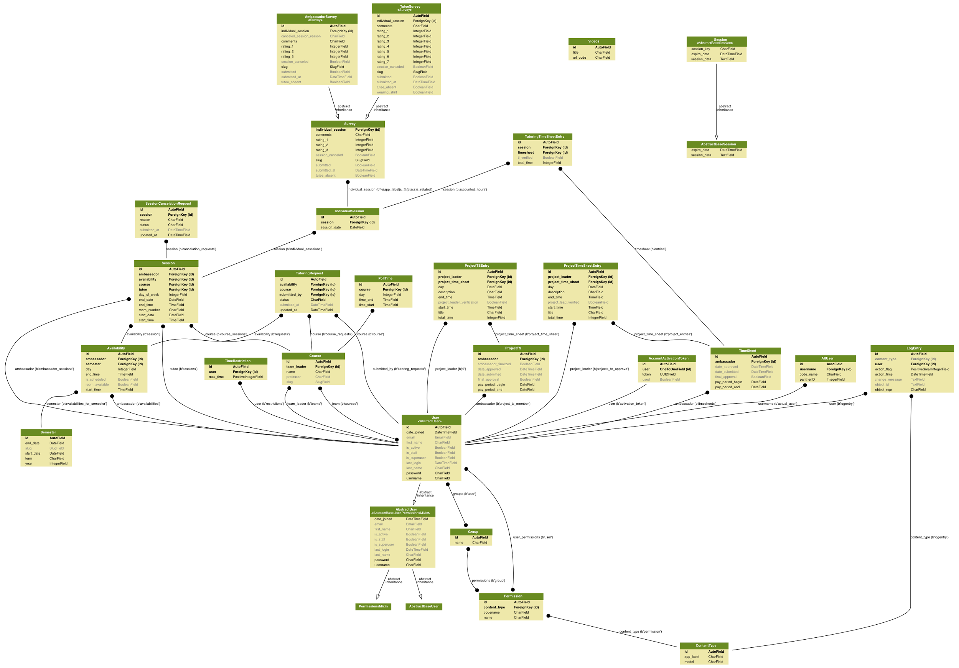
Minimal Class Diagram
Notes:
10 seconds.Minimal class diagram. Highlight the classes that you created/modified
Identify the design patterns used (one or more slides).

Slide 8
User Stories
1. View of Current Tutees
2. View detailed student information
3. Download an excel file of the report
4. View detailed survey by clicking on survey located in surveys by course view
Notes:
5 seconds.
List the user stories that you worked on them.(put in order of importance). Stay focused on the parts that you have been working.

Slide 9
User Story #1
User Story Name: View of Current Tutees Description: As an administrator I would like to view a list of tutees currently attending tutoring sessions in the current semester so that I can navigate to individual student views from the view. Acceptance Criteria The student row shows the student name. The student row shows the student email. The student row shows the student major. The student row shows the student sex. The student row shows a course a student tutoring session is based on. The list of students displayed are currently attending a tutoring session in the current semester.
Notes:
60 seconds
The tile of user story
The most important user story you worked on it. You have to describe this one very well and be proud of that.
Please present and show the complexity of your work, code, algorithms, and technical challenges and technologies you have used. (you could use screenshot if you want. Visual presentations are better than text presentation)
Go into the details of the most important/significant tasks using bullet lists or visual graphs or state chart diagram
Sequence Diagram for this user story is mandatory (in another separate page if required)
Demo using screenshots or GIF (in another separate page if required)

Slide 10
User Story #2
User Story Name: View detailed student information Description: Description: As an administrator I would like to select a student in order to see more detailed information of that student so that I can contact them and differentiate similar students. Acceptance Criteria Student’s first and last name will be displayed Student’s major will be displayed Student’s sex will be displayed Student’s contact information, phone number and email. Student’s courses they are receiving tutoring for will be displayed
Notes:
20 seconds
The tile of user story
Please present and show the complexity of your work, code, algorithms, and technical challenges and technologies you have used. (you could use screenshot if you want. Visual presentations are better than text presentation) - Go into the details of the most important/significant tasks using bullet lists or visual graphs or state chart diagram - Demo using screenshots or GIF (in another separate page if required)
Sequence Diagram for this user story is optional

Slide 11
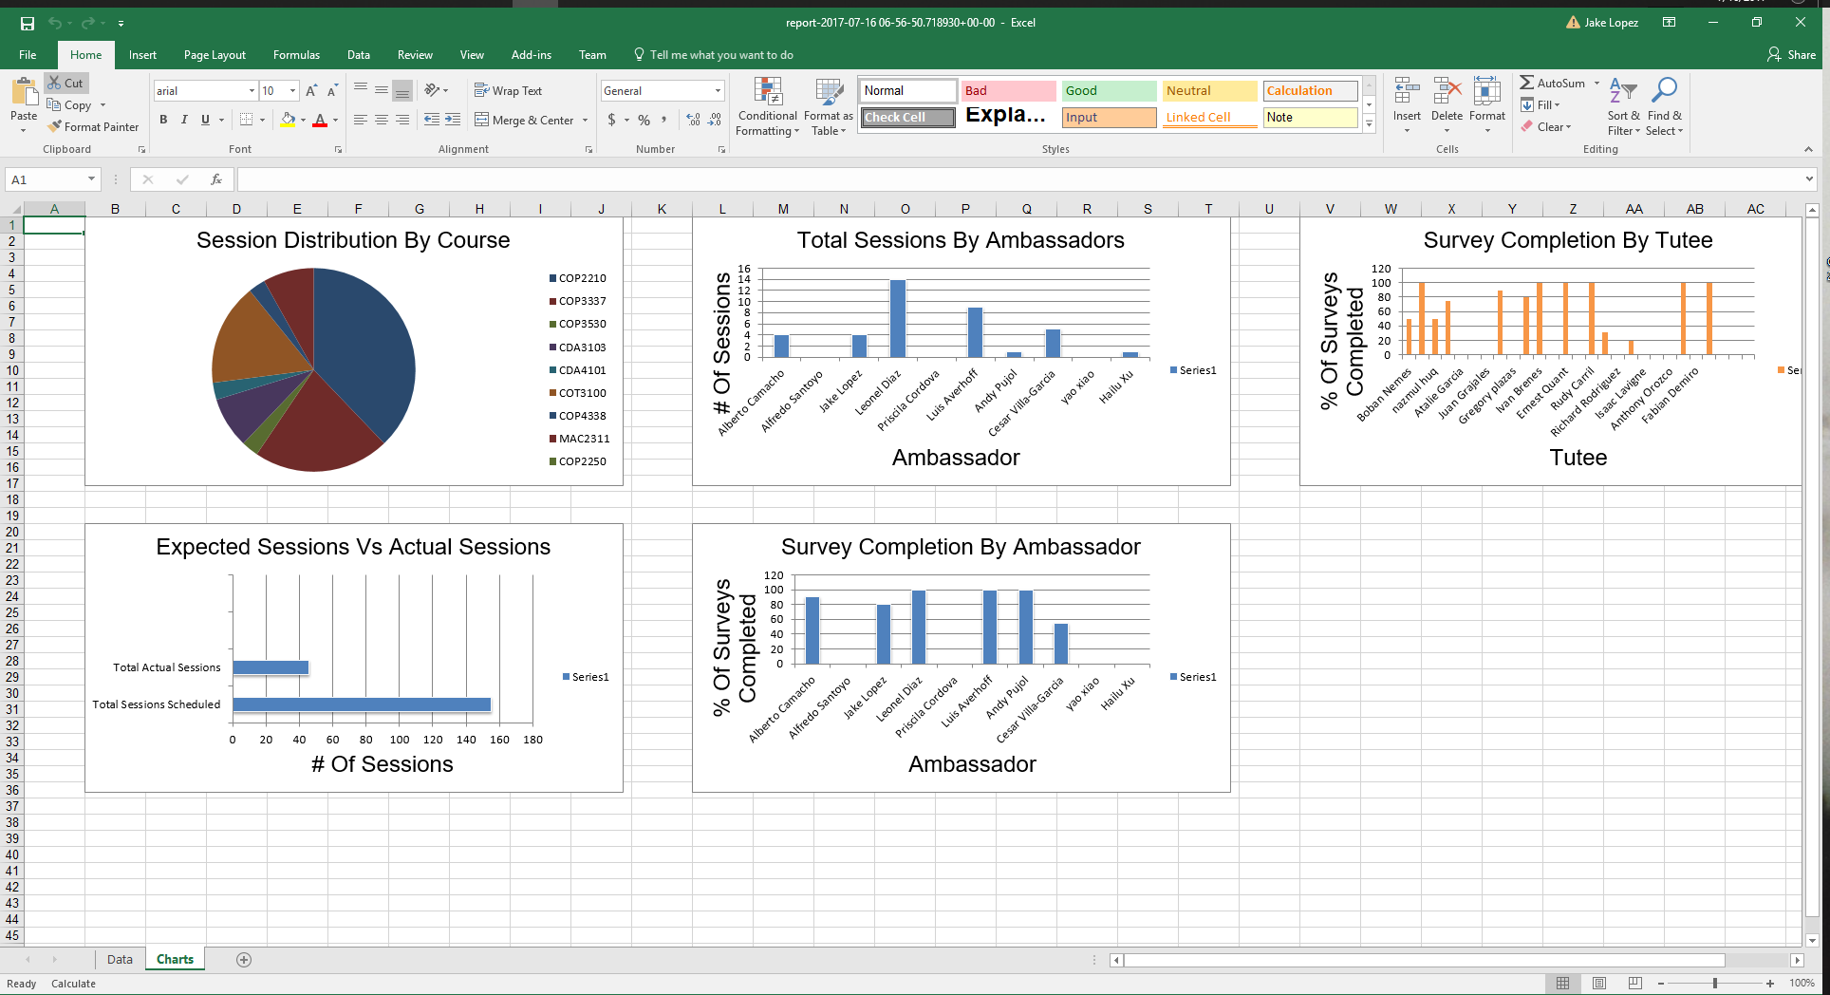
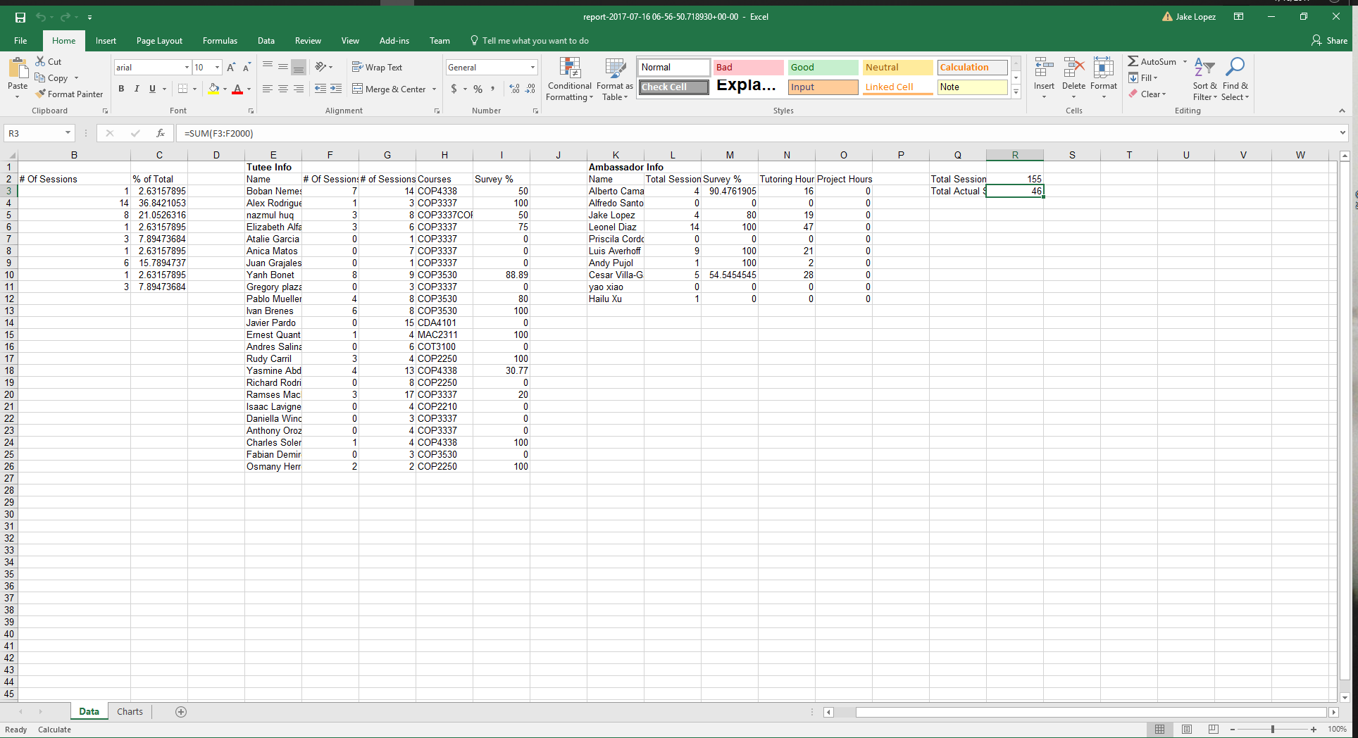
User Story #3
User Story Name: Download an excel file of the report
Description: As an Administrator, I would like to download an Excel version of the Semester report, so I can easily generate scaleable graphs and share the file if need be.
Notes:
20 seconds
The tile of user story
Please present and show the complexity of your work, code, algorithms, and technical challenges and technologies you have used. (you could use screenshot if you want. Visual presentations are better than text presentation) - Go into the details of the most important/significant tasks using bullet lists or visual graphs or state chart diagram - Demo using screenshots or GIF (in another separate page if required)
Sequence Diagram for this user story is optional

Slide 12
User Story #4
User Story Name: View detailed survey by clicking on survey located in surveys by course view Description: As an administrator, I would like to click on a survey summary in order to view the details of the surveys so that I can see the answers to each question Acceptance Criteria: A modal will pop up containing the detailed information Questions of the survey will be displayed Answers to the questions of the survey will be displayed
Notes:
20 seconds
The tile of user story
Please present and show the complexity of your work, code, algorithms, and technical challenges and technologies you have used. (you could use screenshot if you want. Visual presentations are better than text presentation) - Go into the details of the most important/significant tasks using bullet lists or visual graphs or state chart diagram - Demo using screenshots or GIF (in another separate page if required)
Sequence Diagram for this user story is optional

Slide 13
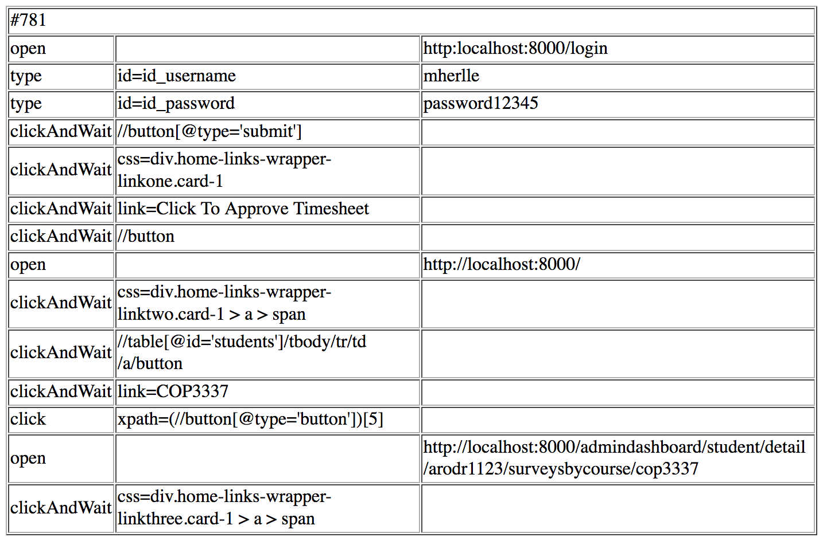
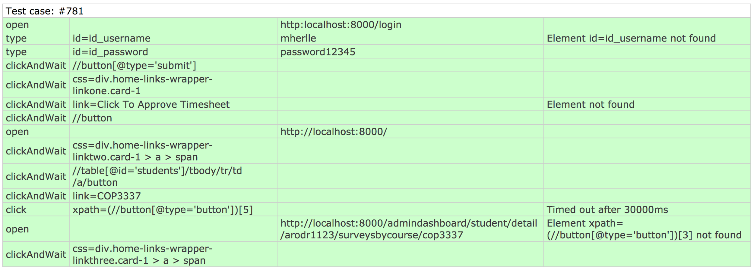
Test Suites and Test Cases
Selenium Test Case # 781
Test Case ID : 781
Purpose: Verify administrator footer viewed in administrator areas.
Preconditions: Administrator in Login Page
Input: Administrator Logs in
Expected Output: Administrator Footer in Administrator Area
Pass/Fail: Pass
Notes:
10 seconds
A description of verification process and Test Suites and Test Cases for one of the use cases.
1 One sunny day and one rainy day for the implemented use cases (one or more slides).
2 Automated test scripts for the implemented use cases (if any) (one or more slides).

Slide 14
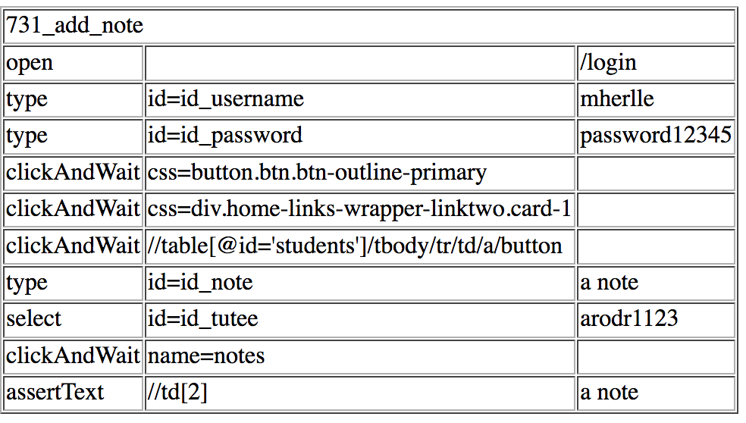
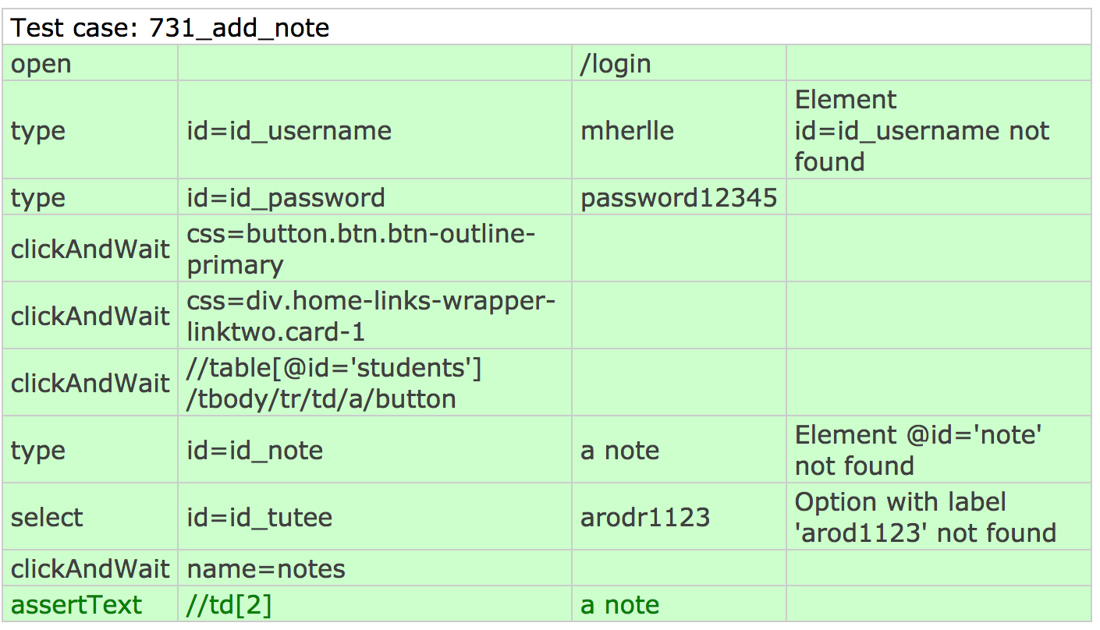
Test Suites and Test Cases
Selenium Test Case # 731_add_note
Test Case ID : 731_add_note
Purpose: Verify administrator can add a note in student details view
Preconditions: Administrator in Student Details
Input: A note in text field id id_note
Expected Output: a_note
Pass/Fail: Pass
Notes:
10 seconds
A description of verification process and Test Suites and Test Cases for one of the use cases.
1 One sunny day and one rainy day for the implemented use cases (one or more slides).
2 Automated test scripts for the implemented use cases (if any) (one or more slides).

Slide 15
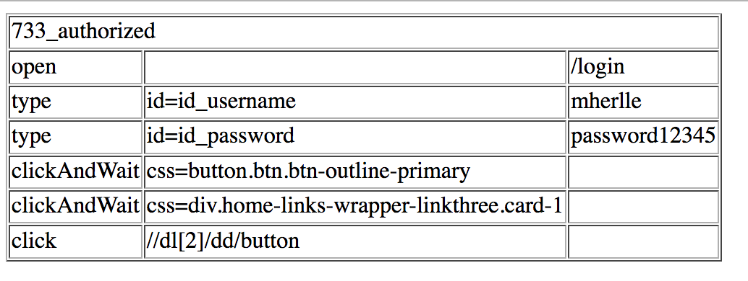
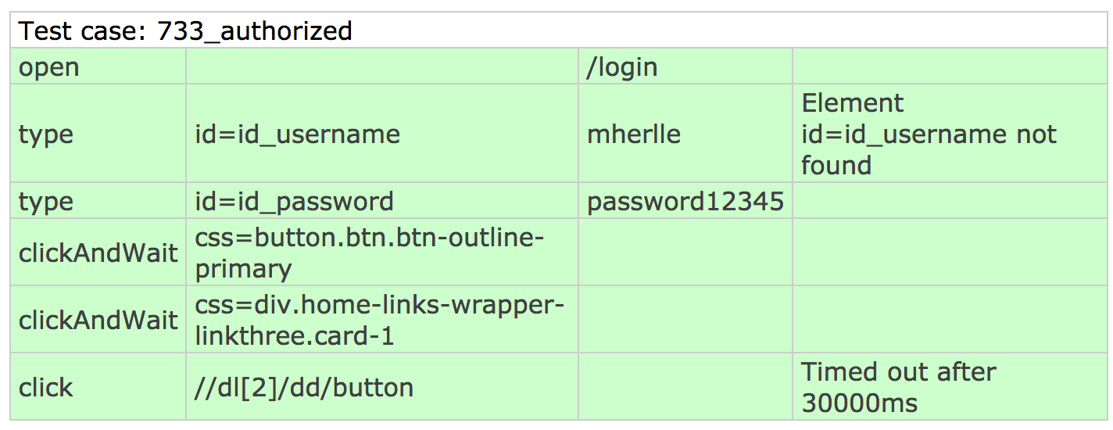
Test Suites and Test Cases
Selenium Test Case # 733_authorized
Test Case ID : 733_authorized
Purpose: Verify only administrator can view semester course information
Preconditions: Administrator in Login Page
Input: Administrator Logs in
Expected Output: Administrator semester report view
Pass/Fail: Pass
Notes:
10 seconds
A description of verification process and Test Suites and Test Cases for one of the use cases.
1 One sunny day and one rainy day for the implemented use cases (one or more slides).
2 Automated test scripts for the implemented use cases (if any) (one or more slides).

Slide 16











Summary
contact information
Questions?
Thank You!
Alfredo Santoyo asant049@fiu.edu
Jake Lopez jlope590@fiu.edu
Priscila Cordova pcord004@fiu.edu
Rolando Moreno rmore071@fiu.edu
Notes:
10 seconds
Summarize your contribution, mention your effort for Scrum, Mingle, Github, Google Drive Documentation and minutes
Include your contact information
Ask if anyone has any questions for you.
Thank your audience

